Slide 1
Chapter 31
Money and
Banking
McGraw-Hill/Irwin
Copyright © 2009 by The McGraw-Hill Companies, Inc. All rights reserved.

Slide 2
Chapter Objectives
The functions of money
Components of the money supply
What “backs” the money supply
The Federal Reserve and the U.S. banking system
The functions and responsibilities of the Federal Reserve
31-2

Slide 3
Functions of Money
Medium of exchange
Used to buy/sell goods
Unit of account
Goods valued in dollars
Store of value
Hold some wealth in money form
Money is liquid
31-3

Slide 4
Money Defined
M1
Currency
Checkable deposits
Institutions offering checkable deposits
Commercial banks
Savings and loan associations
Mutual savings banks
Credit unions
31-4

Slide 5
Money Defined
M2
M1 plus near-monies
Savings deposits including money market deposit accounts (MMDA)
Small time deposits
Money market mutual funds (MMMF)
31-5

Slide 6
Money Defined
M1
M2
January 2008
Currency
+
56%
M1
Checkable Deposits
+
44%
18%
Small Time Deposits
+
16%
Money Market Mutual
Funds Held By Individuals
14%
+
Savings Deposits,
Including Money Market
Deposit Accounts
52%
+
Totals
$1,365
Billion
$7,499
Billion
Source: Federal Reserve System
31-6

Slide 7
Money Supply
Are credit cards money?
What “backs” the money supply?
Nothing!
Why is money valuable?
Acceptability
Legal tender
Relative scarcity
31-7

Slide 8
Money and Prices
Prices affect purchasing power of money
Hyperinflation renders money unacceptable
Stabilizing money’s purchasing power
Intelligent management of the money supply – monetary policy
Appropriate fiscal policy
31-8

Slide 9
Federal Reserve System
Historical background
Board of Governors
12 Federal Reserve Banks
Serve as the central bank
Quasi-public banks
Banker’s bank
31-9

Slide 10
Federal Reserve System
Board of Governors
Federal Open Market Committee
12 Federal Reserve Banks
Commercial Banks
Thrift Institutions
(Savings and Loan Associations,
Mutual Savings Banks,
Credit Unions)
The Public
(Households and
Businesses)
31-10

Slide 11
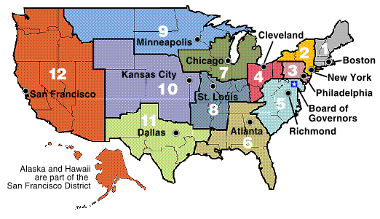
Federal Reserve System
The 12 Federal Reserve Banks
Source: Federal Reserve Bulletin
31-11

Slide 12
Federal Reserve System
Federal Open Market Committee
Aids Board of Governors in setting monetary policy
Conducts open market operations
Commercial banks and thrifts
7,300 commercial banks
11,000 thrifts
31-12

Slide 13
Federal Reserve Functions
Issue currency
Set reserve requirements
Lend money to banks
Set discount rate
Check collection
Fiscal agent for U.S. government
Supervise banks
Control the money supply
31-13

Slide 14
Federal Reserve System
Federal Reserve independence
Recent developments
Relative decline of banks and thrifts
Consolidation
Convergence of services provided by financial institutions
Globalization of financial markets
Electronic payments
31-14

Slide 15
Financial Institutions
World’s 12 Largest Financial Institutions, 2007
Assets (Billions of U.S. Dollars)
0 1,300,000 1,600,000 1,900,000
Barclays (UK)
BNP Paribas (France
Citigroup (USA)
HSBC Group (UK)
UBS (Switzerland)
Royal Bank of Scotland (UK)
ING Group (Netherlands)
Mitsubishi UFJ (Japan)
Deutsche Bank Group (Ger)
Bank of America (US)
Allianz Worldwide (Ger)
JPMorgan Chase (USA)
Source: Organization for Economic Cooperation and Development
31-15

Slide 16
U.S. Financial Institutions
Commercial banks
Thrifts
Insurance companies
Mutual fund companies
Pension funds
Securities firms
Investment banks
31-16

Slide 17
The Global Greenback
U.S. currency circulating abroad
Russia $80 billion
Argentina $50 billion
$450 billion total
60% of total US currency
U.S. profits from dollars leaving
Black markets and illegal activities
Dollar offers stable purchasing power
Exchange rate risk
31-17

Slide 18
Key Terms
medium of exchange
unit of account
store of value
M1
Federal Reserve Notes
token money
checkable deposits
commercial banks
thrift institutions
near-monies
M2
savings account
money market deposit account (MMDA)
time deposits
money market mutual fund (MMMF)
legal tender
Federal Reserve System
Board of Governors
Federal Reserve Banks
Federal Open Market Committee (FOMC)
financial services industry
electronic payments
31-18

Slide 19
Next Chapter Preview…
Money
Creation
31-19

